Slide 1
Object-Oriented Programming
Week 1 | Lecture 1

Slide 2
About this course
“Object-oriented Programming”
Course code: CS-217 Course Teacher: Syed Zain Ul Hassan
Marks Distribution: Assignments 10%
Quizzes 10%
Project 15%
Mid Exam 20% (10% each)
Final Exam 45%

Slide 3
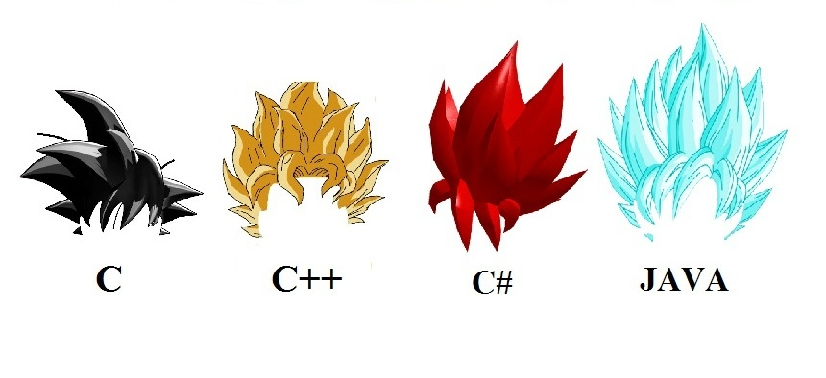
Programming Paradigms
A programming paradigm is a style, or “way,” of programming

Slide 4
Some Programming Paradigms
Structural
Programming with clean, goto-free, nested control structures
Procedural
Programming with function calls that avoid any global state
Object-oriented
Programming by using objects that use each other

Slide 5
Principles of Object-oriented Programming
There are five basic principles of Object-oriented Programming:
Encapsulation
Abstraction
Inheritance
Polymorphism
Code reuse
“Don’t worry if these terms seem scary at this point”!

Slide 6
Object-oriented Languages
There are many languages which use the object-oriented “way of programming”
Some popular ones are C++, C# and JAVA

Slide 7
Study Guide
Books:
Problem Solving with C++, 9e Global Edition, Walter Savitch, ISBN-13:9781292018249, Addison-Wesley, 2015
C++ How to program By Deitel & Deitel 7th edition
Reference Books:
The C++ Programming Language by Bjarne Stroustrup
Object Oriented Software Engineering by Jacobson
C# 4.0: The Complete Reference by Herbert Schildt

